Slide 1
Cinderella
Jingtao Wang

Slide 2
Plot
Three bullies invaded a village. A girl escaped and went to her friend Cinderella for help. Cinderella agreed without knowing what’s her up against…

Slide 3
Animation

Slide 4

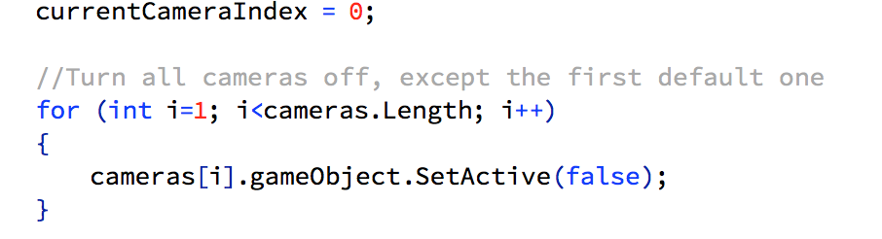
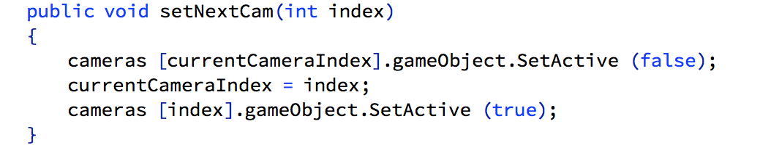
Controlled by CameraController

Slide 5
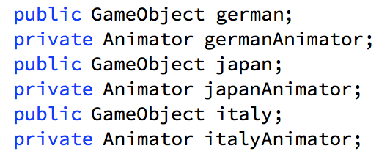
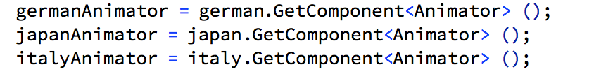
Control of the Characters

Slide 6


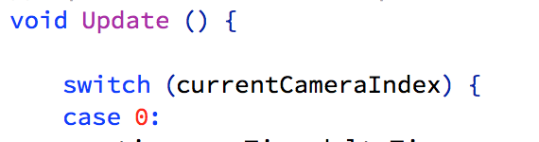
Flow of the Plot

Slide 7

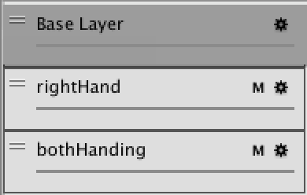
Animation Control

Slide 8
Thank you!

